Slide 1


Slide 2
Your First WordPress Site
WordPress Is free, Your Time Isn’t
–Someone @wcnyc (I think)

Slide 3
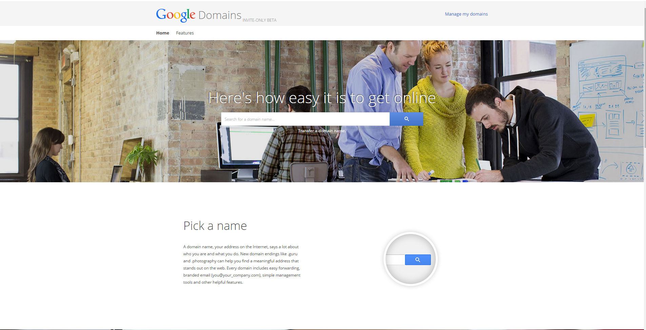
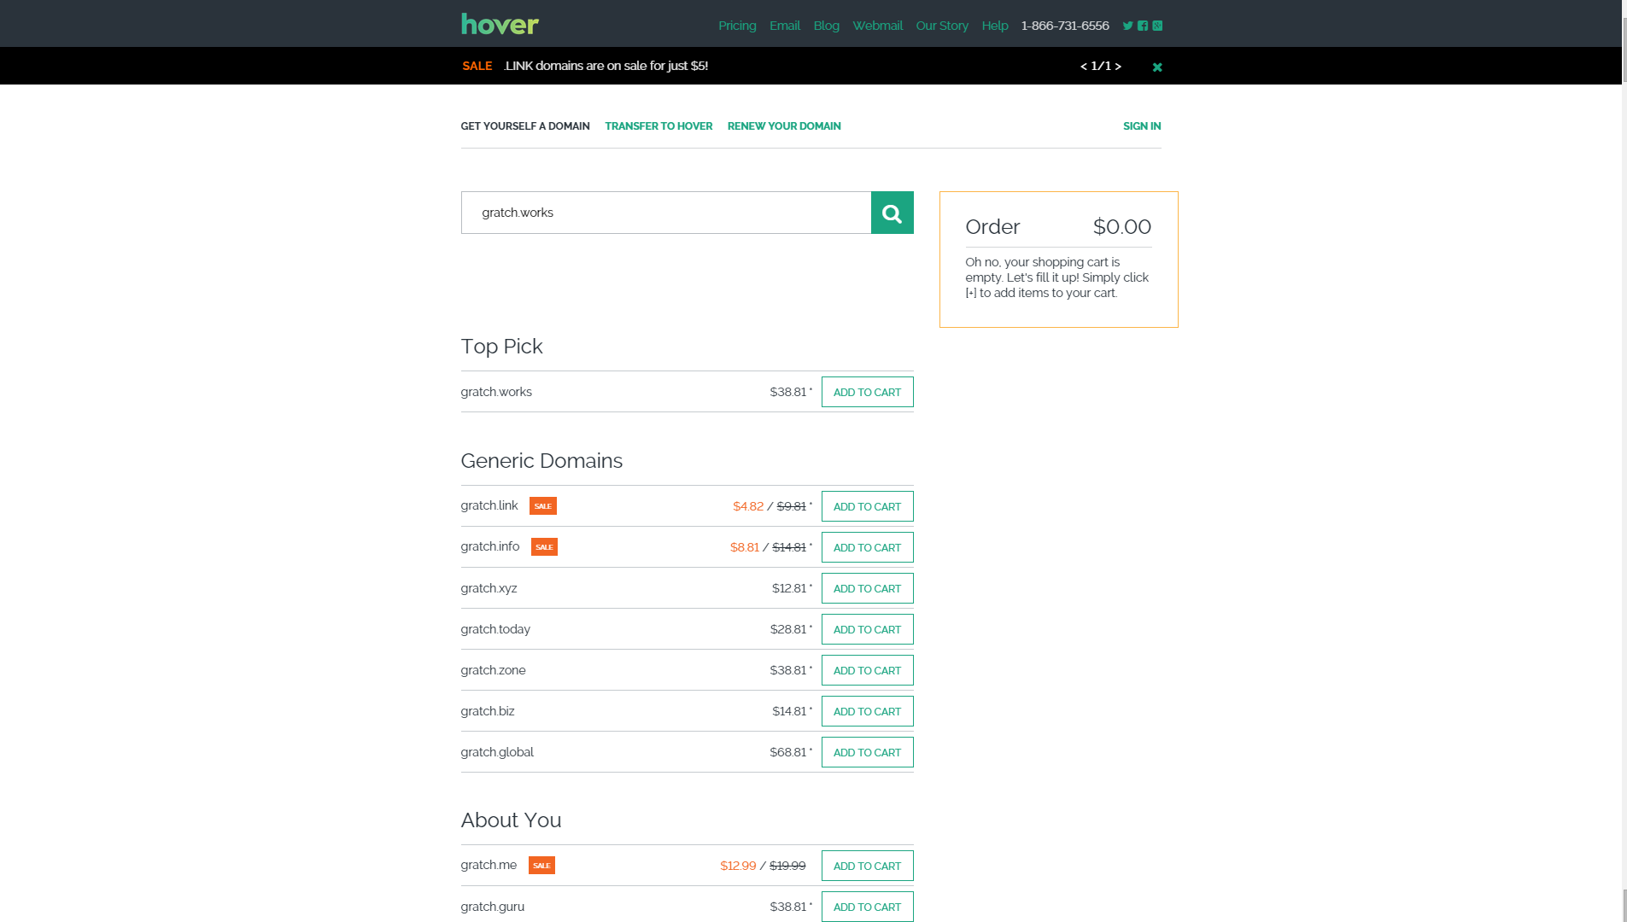
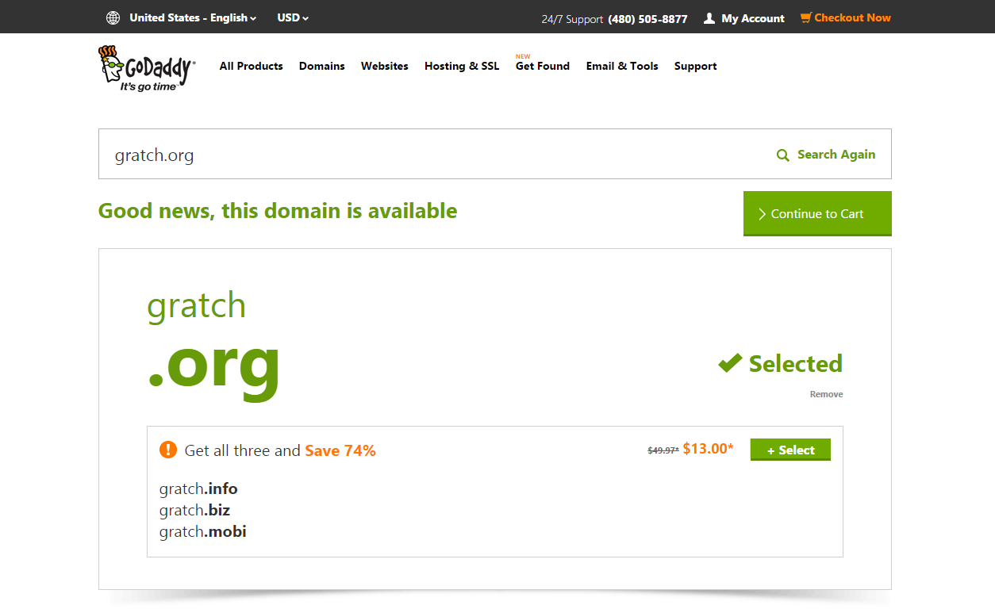
Get a Domain
Find & Register a domain:
godaddy.com
domains.google.com
www.hover.com
Siteground.com
Many, many more

Slide 4
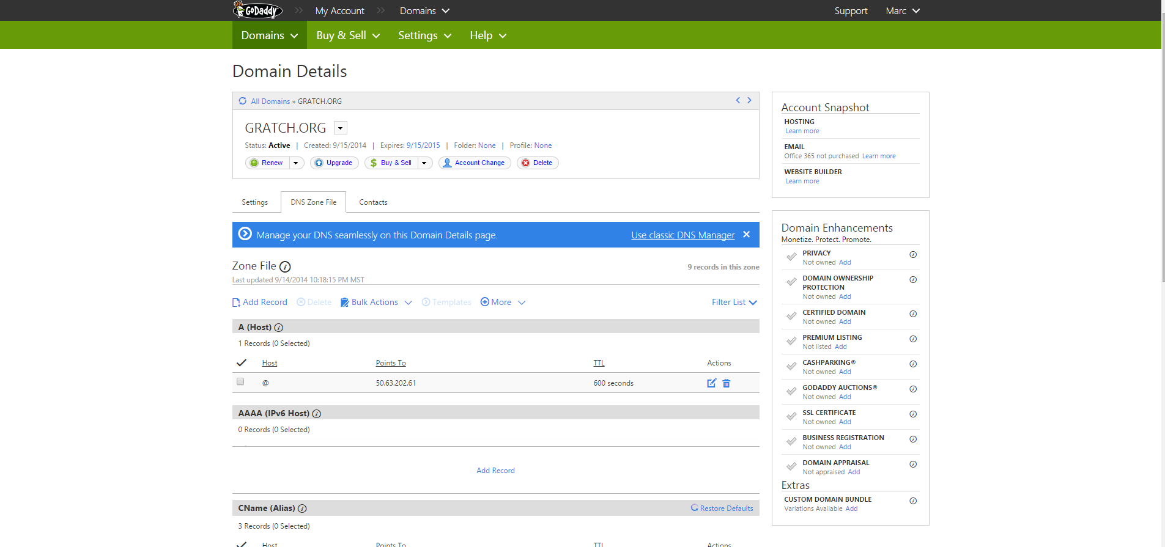
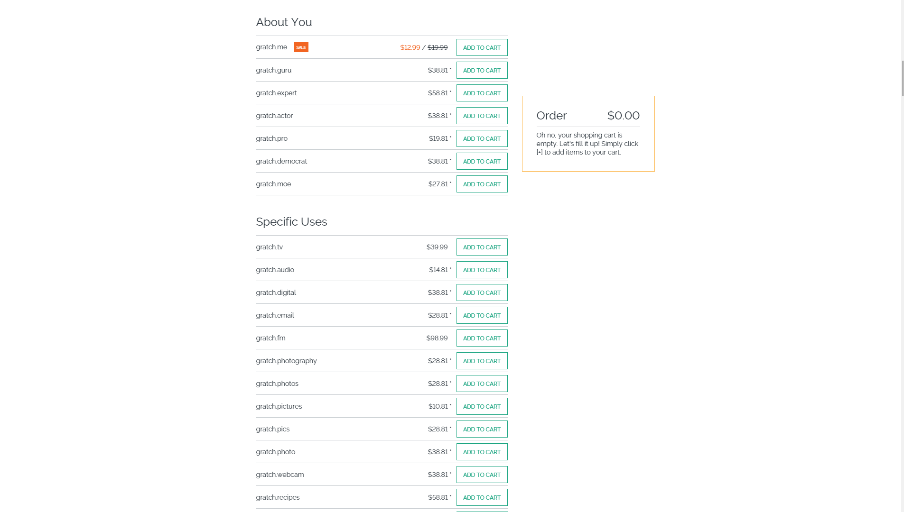
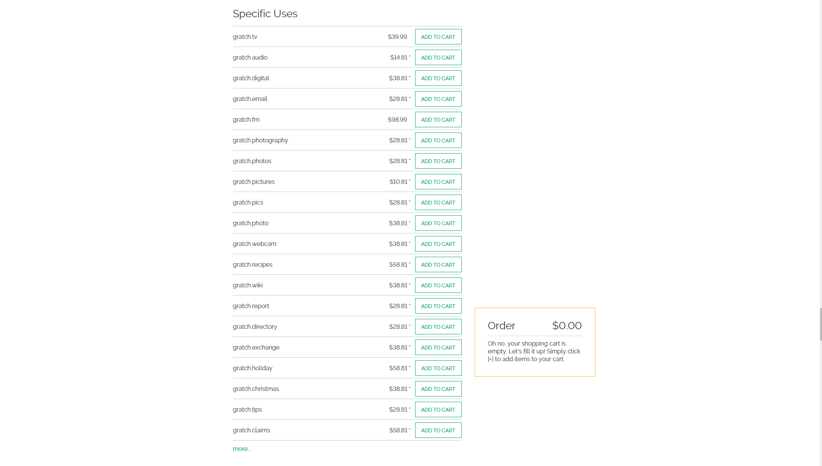
All-in-One Solutions VS Specialized Domain Management
Godaddy/Siteground & other well known All-in-one solutions
Hover & other Specialized domain management
You can typically register a domain name in as little as 5 steps.
They advertise to you at every possible step.
Hover has blown me away by how many Top Level Domains are offered and how clean and simple the interface is.

Slide 5
Hosting your Site
All-in-One Solutions (Godaddy & Siteground)
One stop shops
Many (many) hosting options
Email
SSL
Marketing
SEO
They will try and sell all of these services and more at every interaction.
Hosting Options Available:
Managed WordPress Hosting
Dedicated Hosting
VPS Hosting
Shared Hosting
There are many possibilities of where you can host your new site.

Slide 6
Managed Hosting
Managed Hosting Is Great!
Security
Speed
Daily Backups
Automatic Updated (Some even update your plugins)
One Click Backups
Stellar Support From WordPress Experts
Options tailored for WordPress Site Owners
Somewhere along the lines, I decided I like WordPress. Now I just need to stop playing sysadmin and get managed hosting.
-@derickbailey

Slide 7
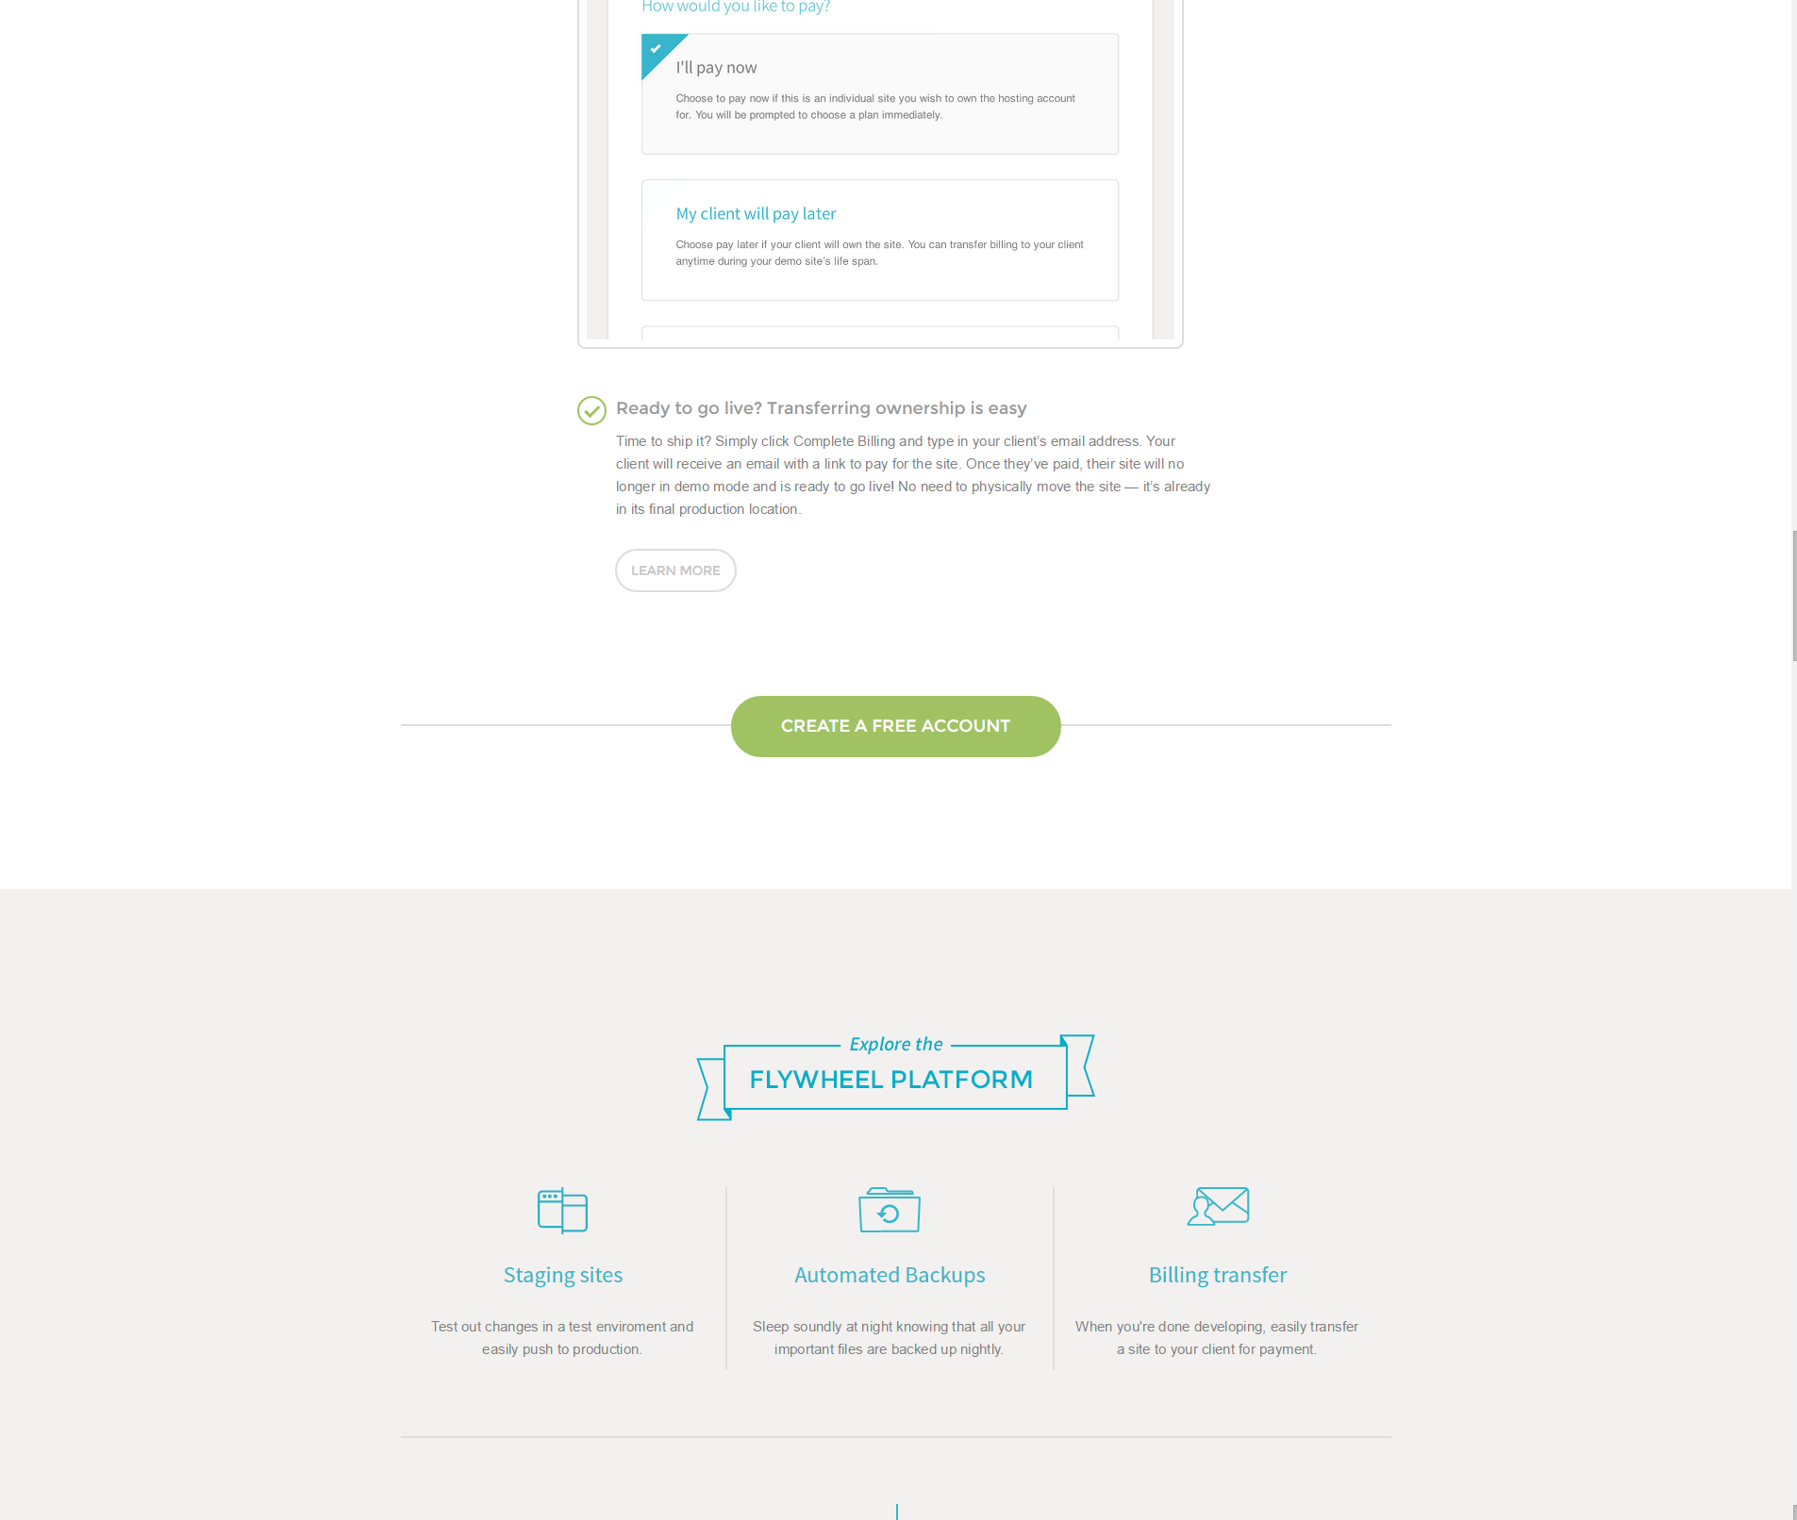
Get Hosting Setup
The following example are using FlyWheel for hosting, because:
Speed
Support
Free trial
You set it up and the client pays the bill.

Slide 8
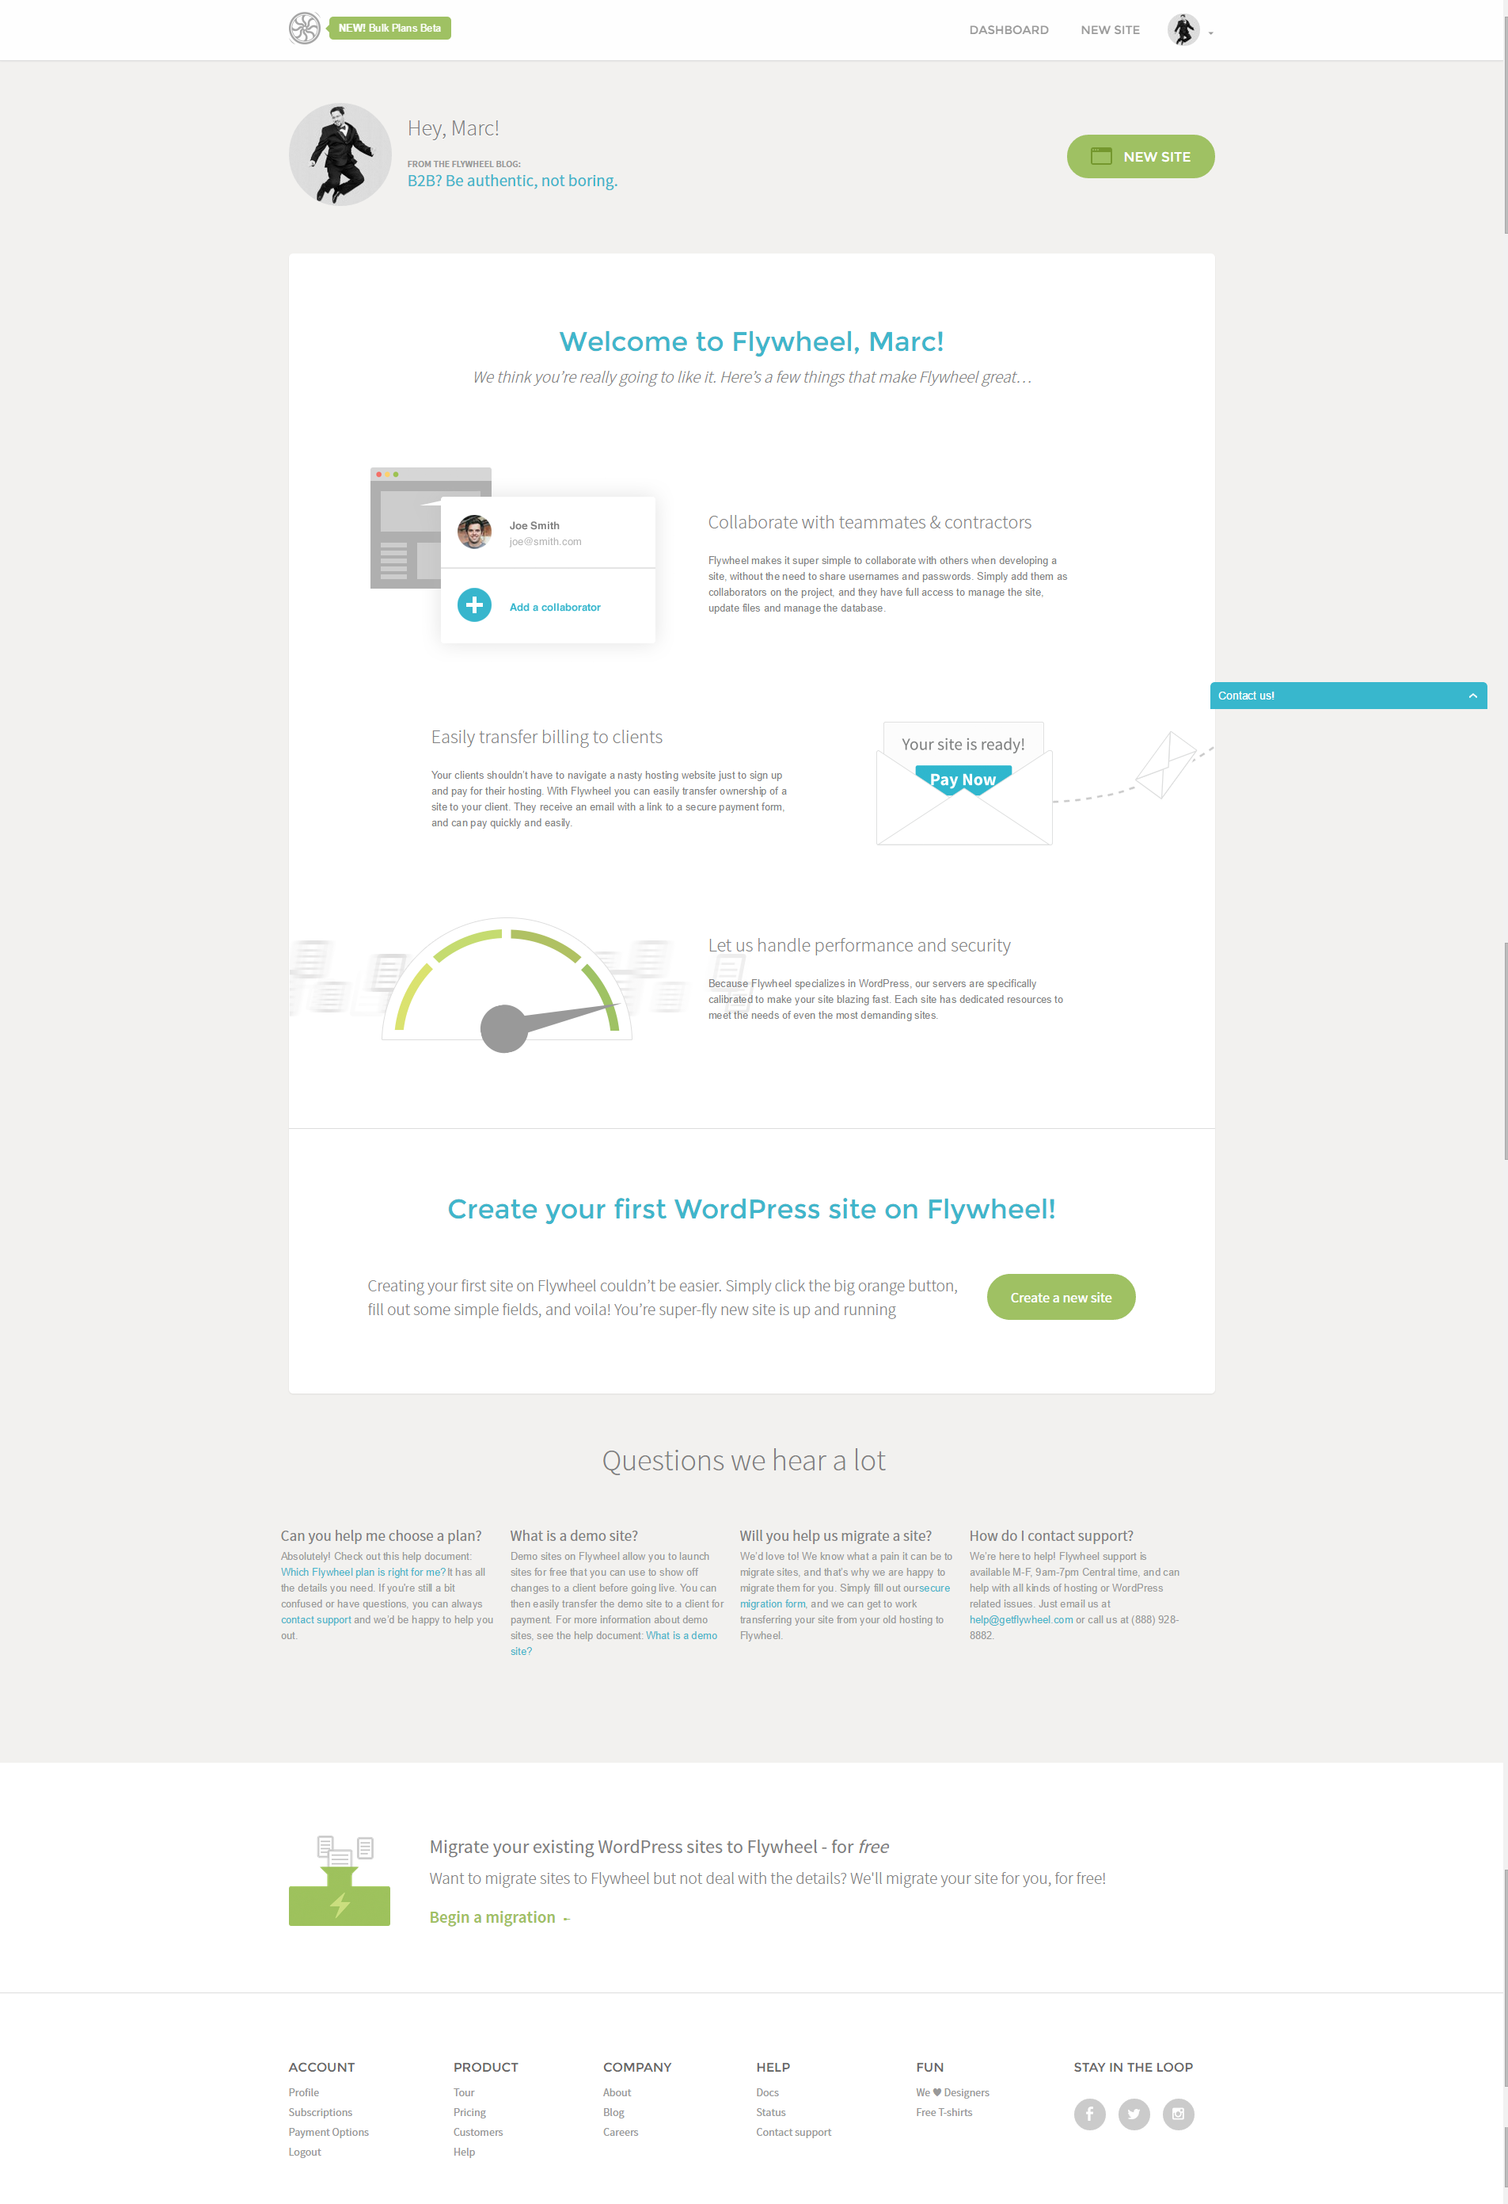
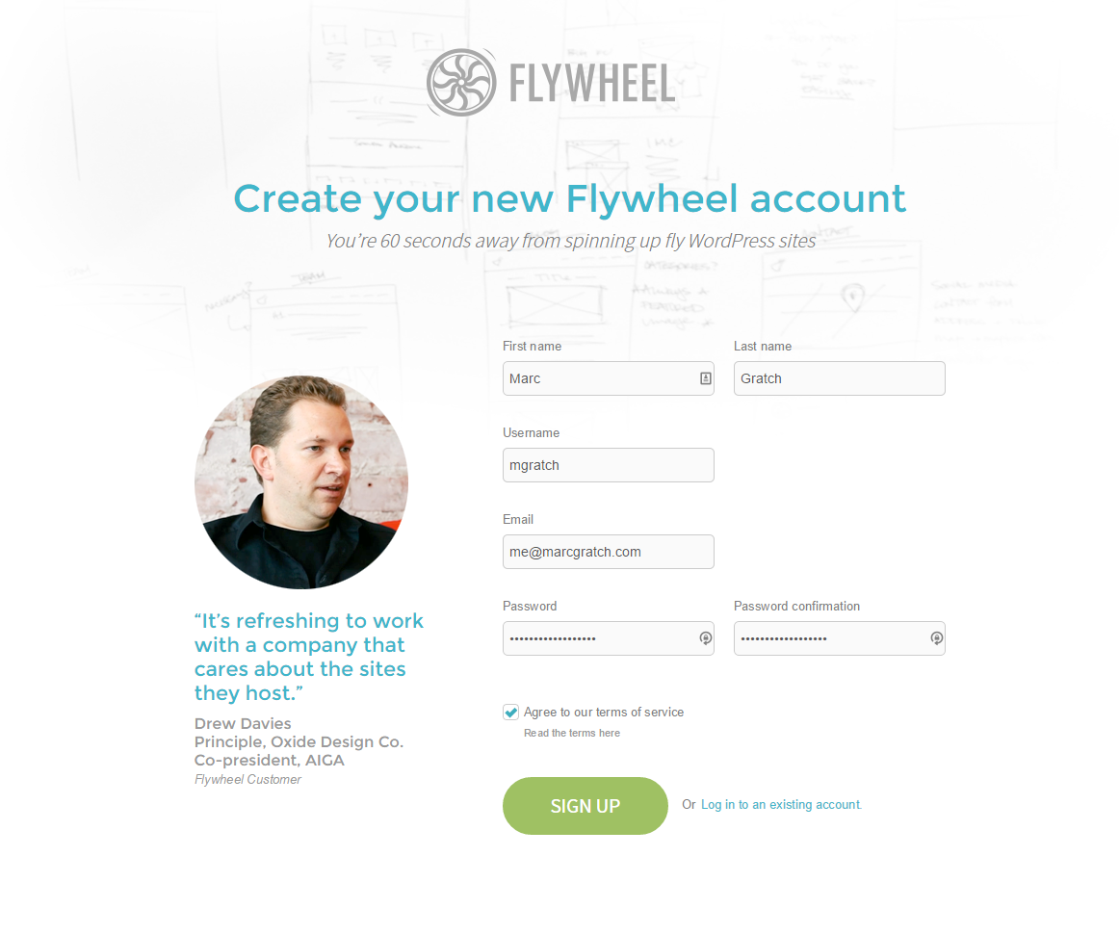
Simple Setup
Get the site up now, Pay later. Or have the client pay for it.

Slide 9
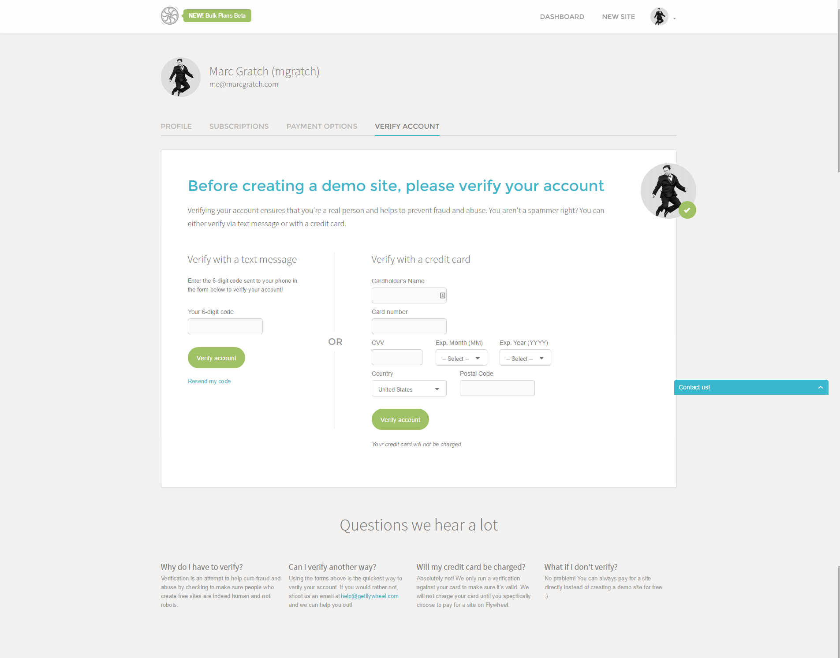
Demo Site
It is worth mentioning that there is a verification step if you are going to create a demo site and pay later.

Slide 10
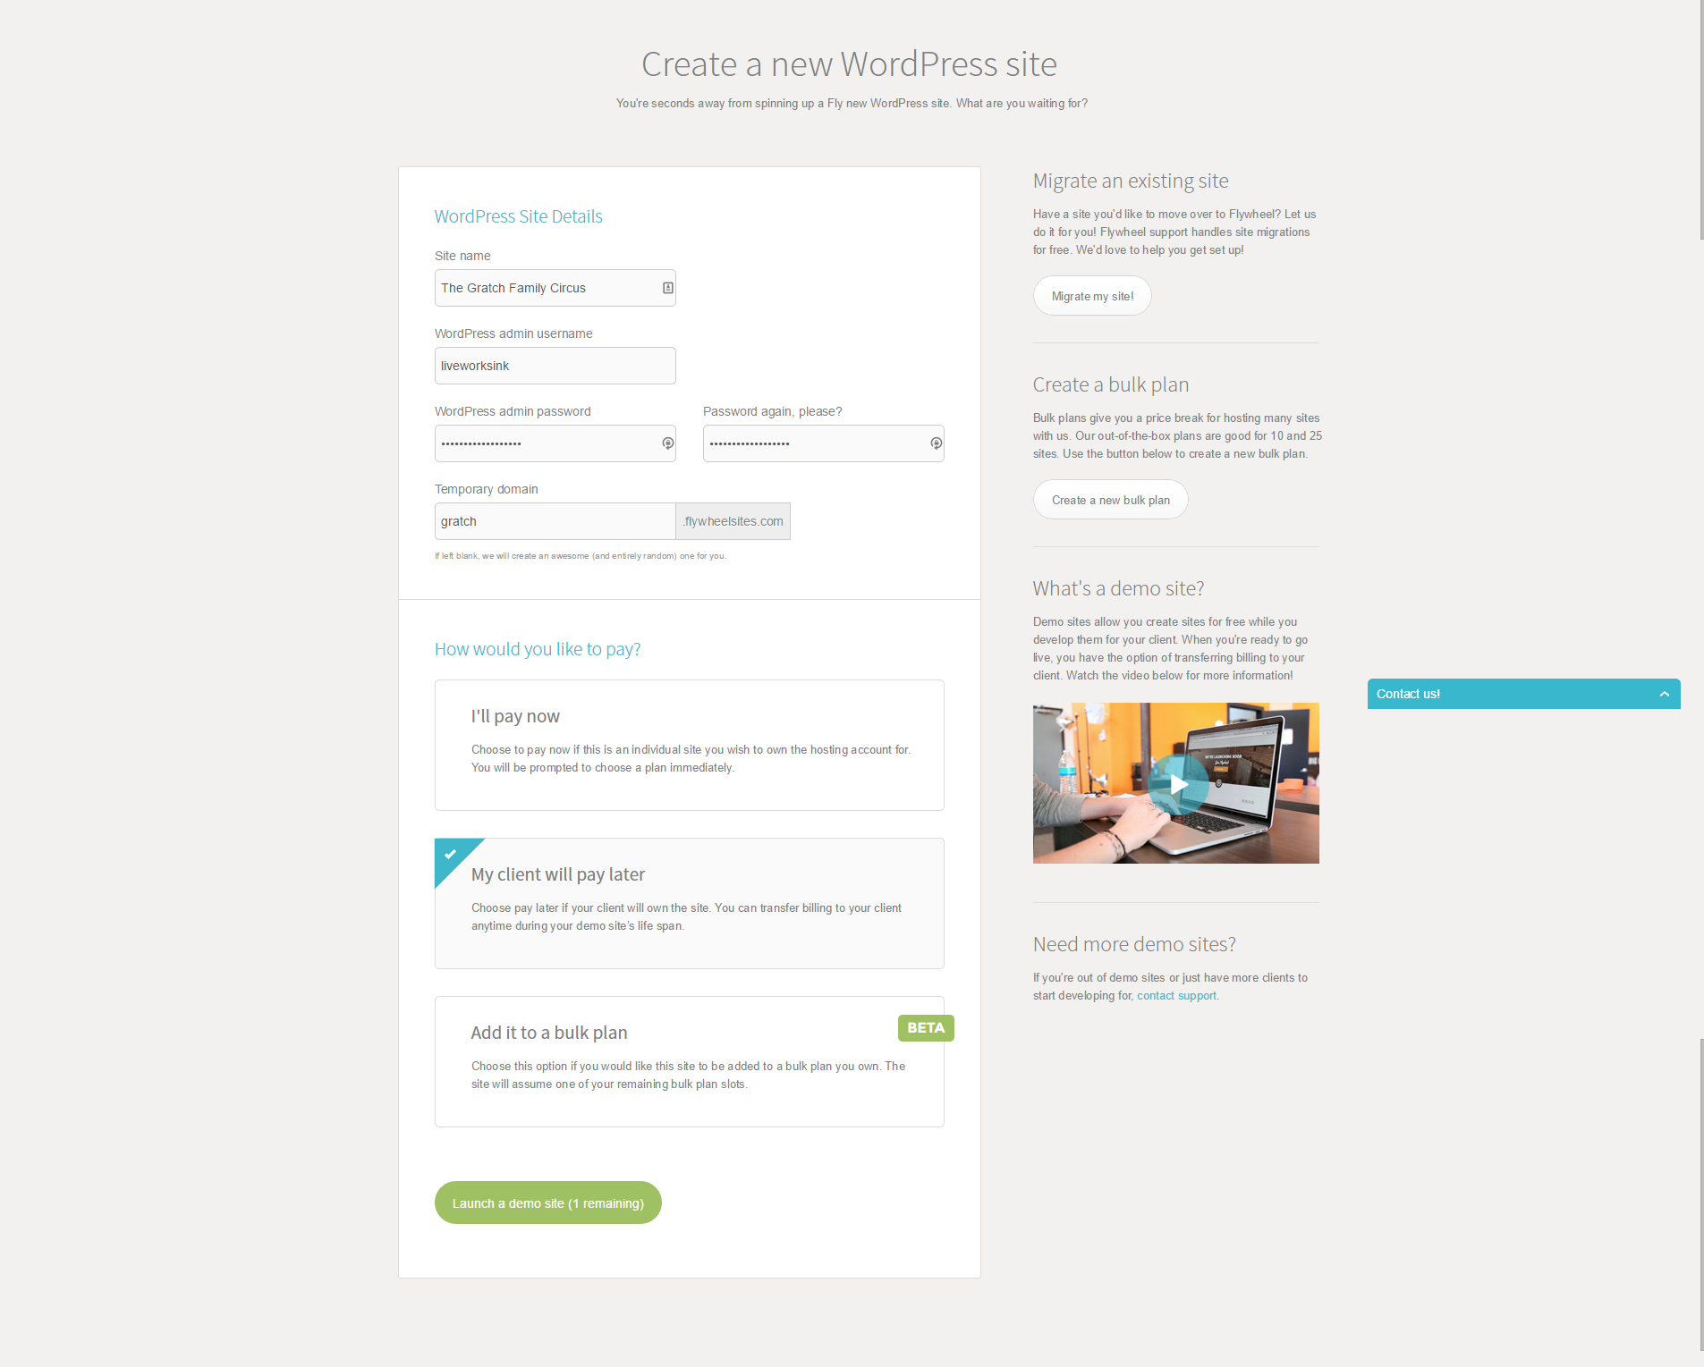
5 Minute Install
FlyWheel’s Version of the WordPress 5 minute install. This is includes selecting payment options.

Slide 11
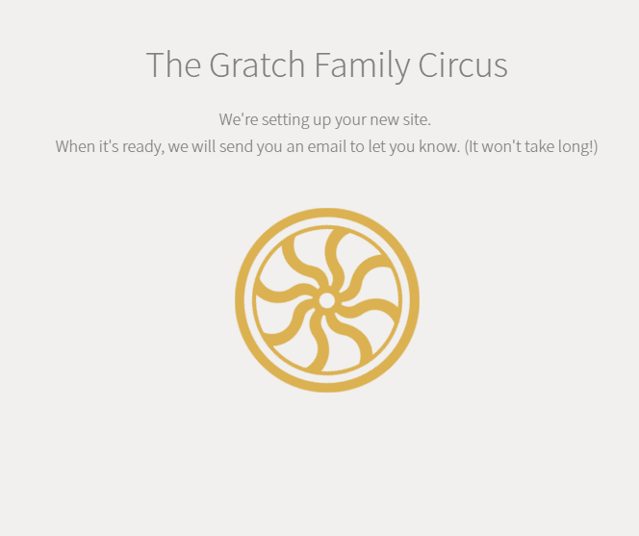
That’s It, hosting is done. (For Now.)
Now it will take a few minutes, and your site will be available to start editing.

Slide 12
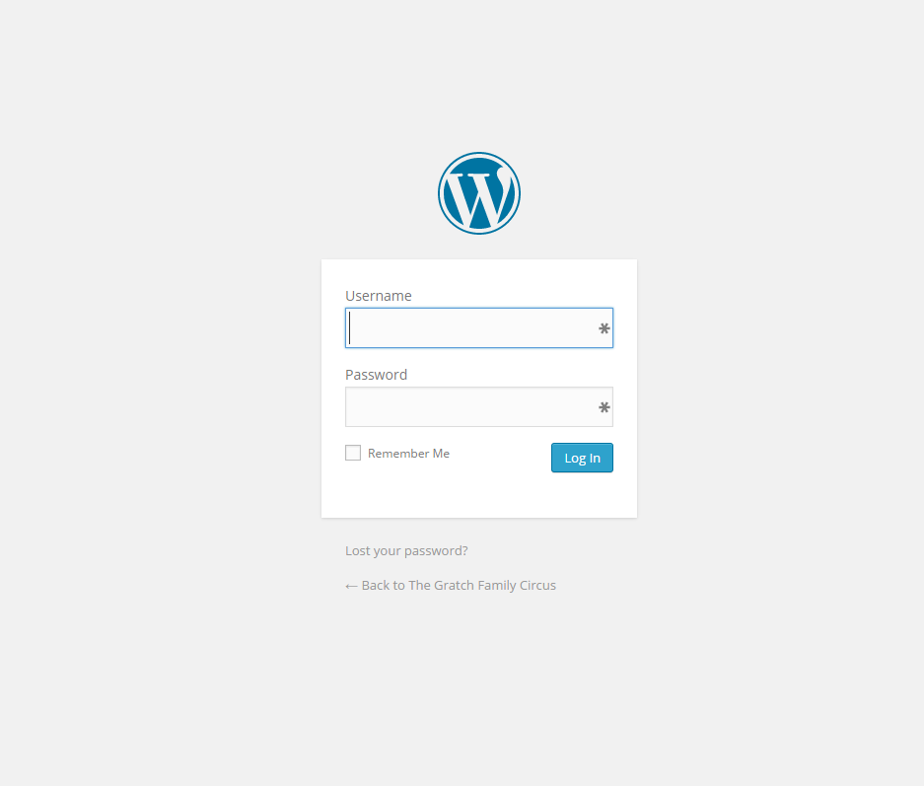
Where Is My Dashboard? (What is a dashboard?)
“The Dashboard is the first screen you see when you log into the administration area of your blog.”
- http://en.support.wordpress.com/dashboard/
Your WordPress Dashboard can be found (usually) at:
yourdomain.com/wp-admin

Slide 13
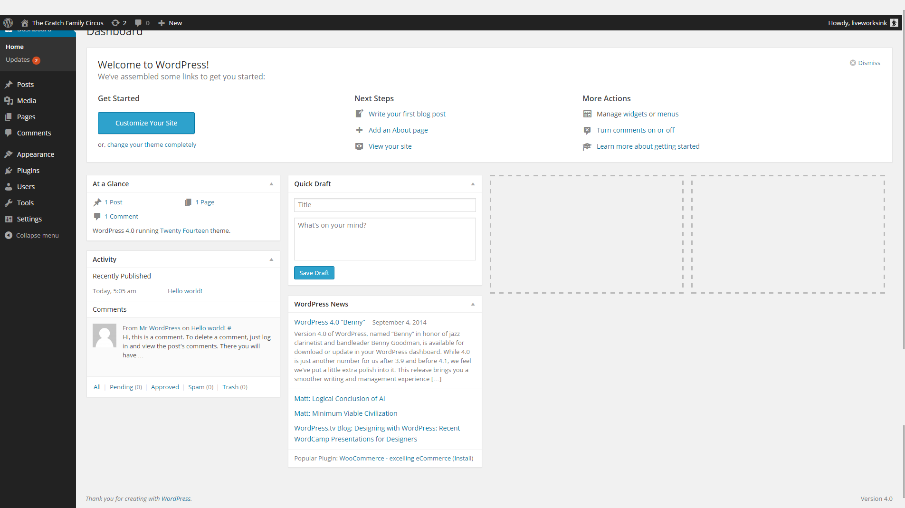
Welcome to the Dashboard!
Take a deep breath.
Everyone gets overwhelmed the first time.
It is very manageable, you can do it.

Slide 14
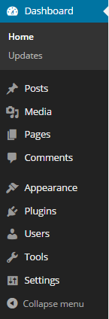
Welcome to the Dashboard!
The top half of the navigation is devoted to content (and updates.)
The Bottom half is devoted to everything else.
Theme options
Plugins (Function-ality)
Users
Settings
Other Tools
This is the main navigation for the WordPress dashboard.
90% of the time, whatever you need is in the navigation on the left side of the dashboard.
*made up statistic

Slide 15
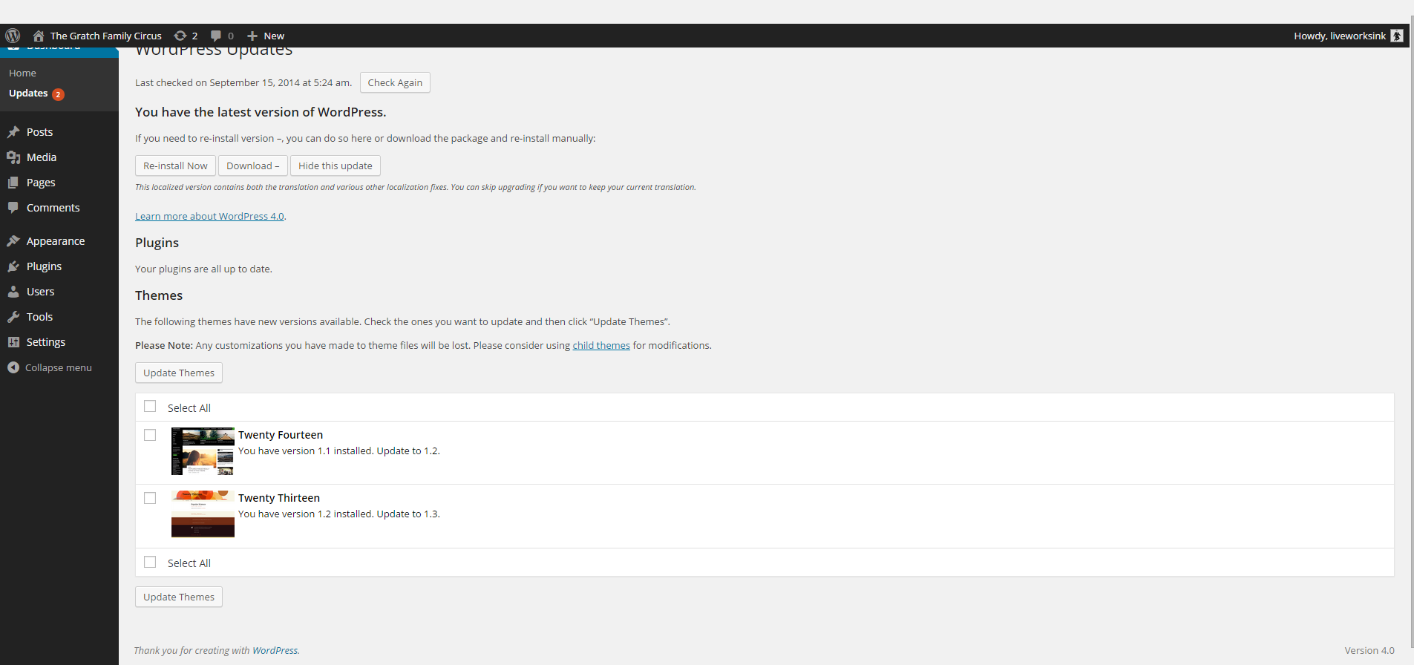
Hey Look an Update.
Updates are important
Make sure you have a backup of your site before updating.
If you are using a managed host updates may be handled for you.

Slide 16
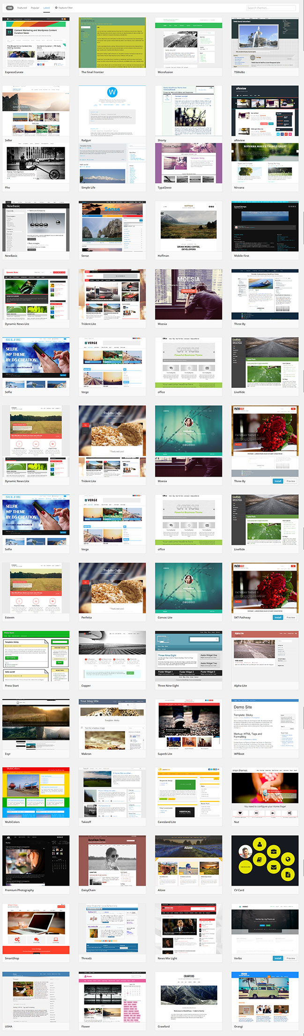
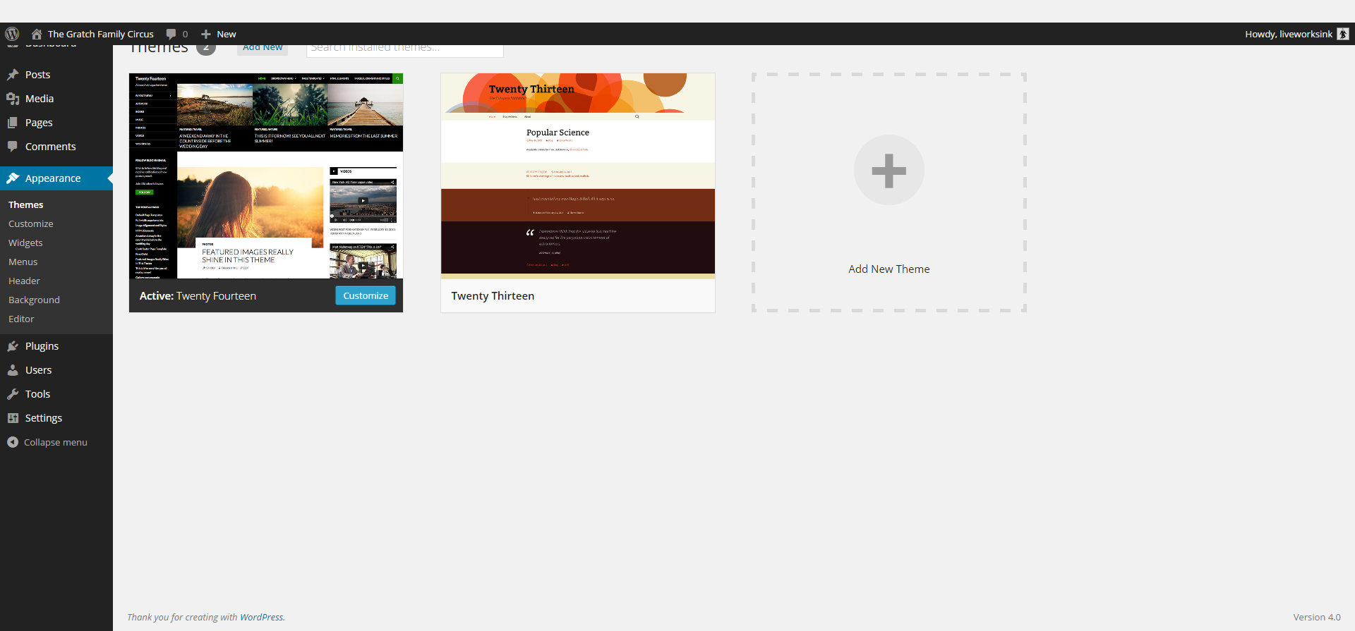
There are a lot of themes to choose from.
WordPress has 2,765 free themes available in the directory. (September 14’)
Do NOT download a free WordPress theme that is not hosted in the WordPress directory.*
*Certain exceptions may apply, but be very sure of the source.

Slide 17
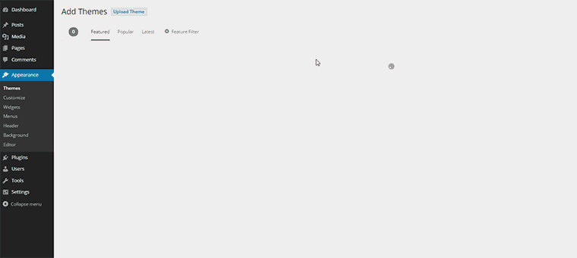
Test the theme that’s right for you.
WordPress offers a live preview of themes in the themes directory.
After you review the theme right for you, click install.

Slide 18
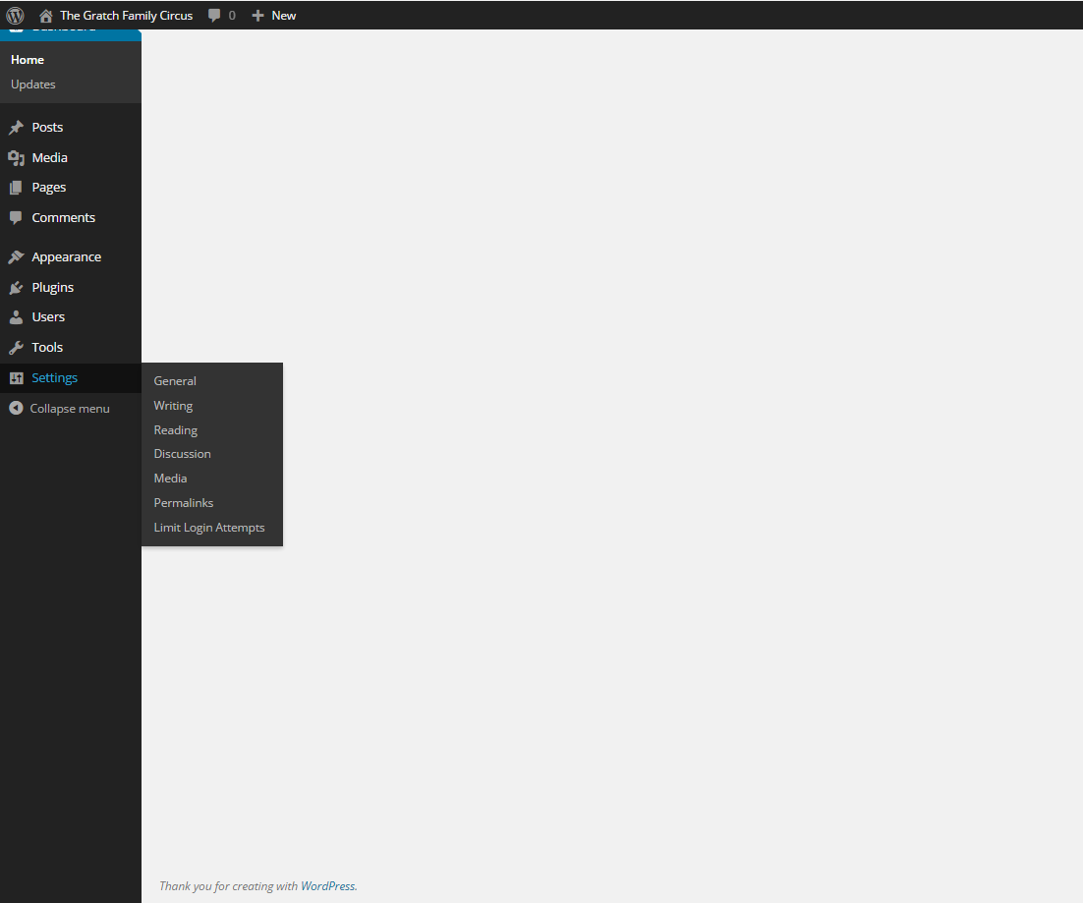
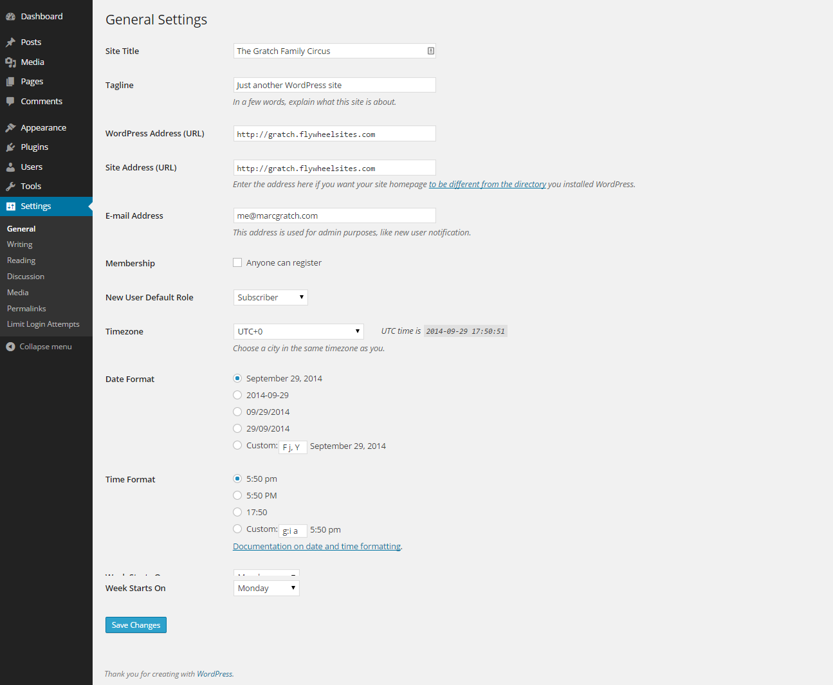
Quick Set Up
This is my process, do what works best for you!
Check out General Settings
Email address
Date/Time Settings
Timezone

Slide 19
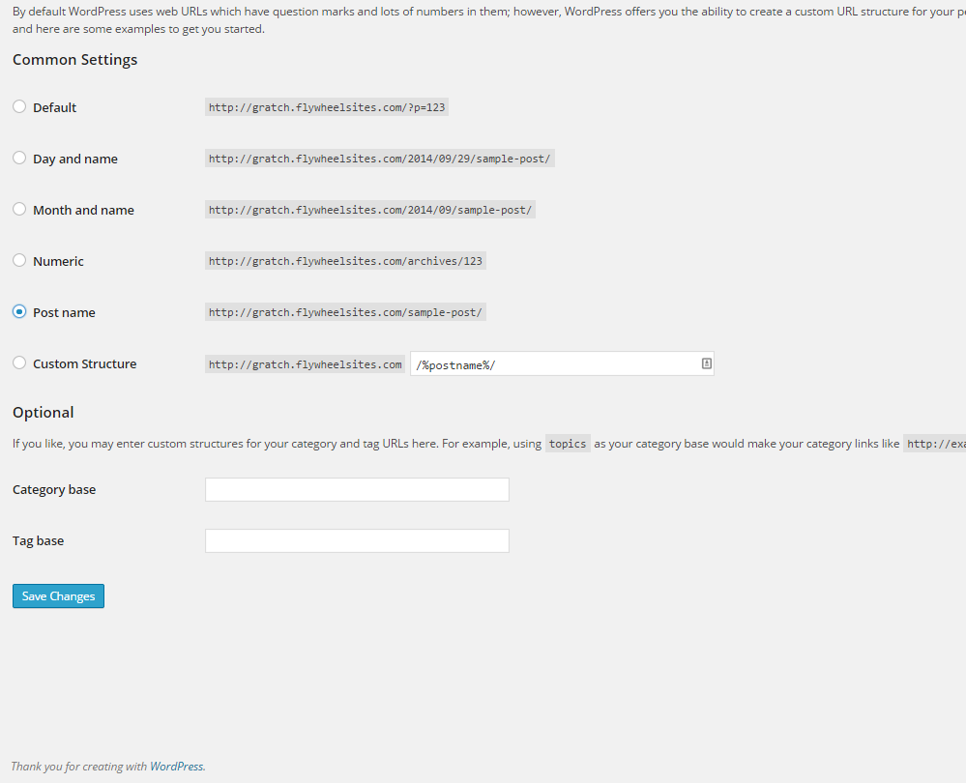
Quick Set Up
This is my process, do what works best for you!
Change Permalinks
Under most circumstances choose “Post Name”

Slide 20
What’s the difference between Posts and Pages?!
Posts:
Pages:
Not Hierarchal (no sub-posts)
Have a time stamp (usually)
Categorized
Show up in RSS Feed
Use Post Formats
Shown in reverse chronological order (by default)
Can Be Hierarchal
Can use custom Templates (when available)
Typically used for static pages, i.e. “About Us”

Slide 21
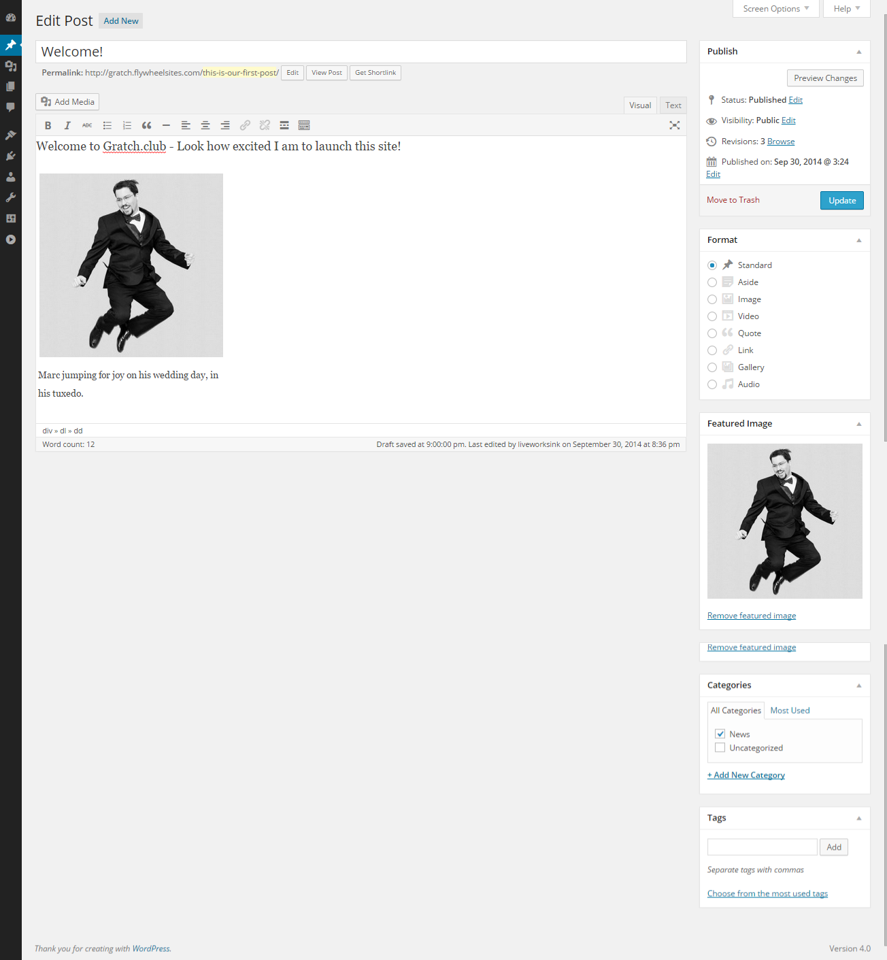
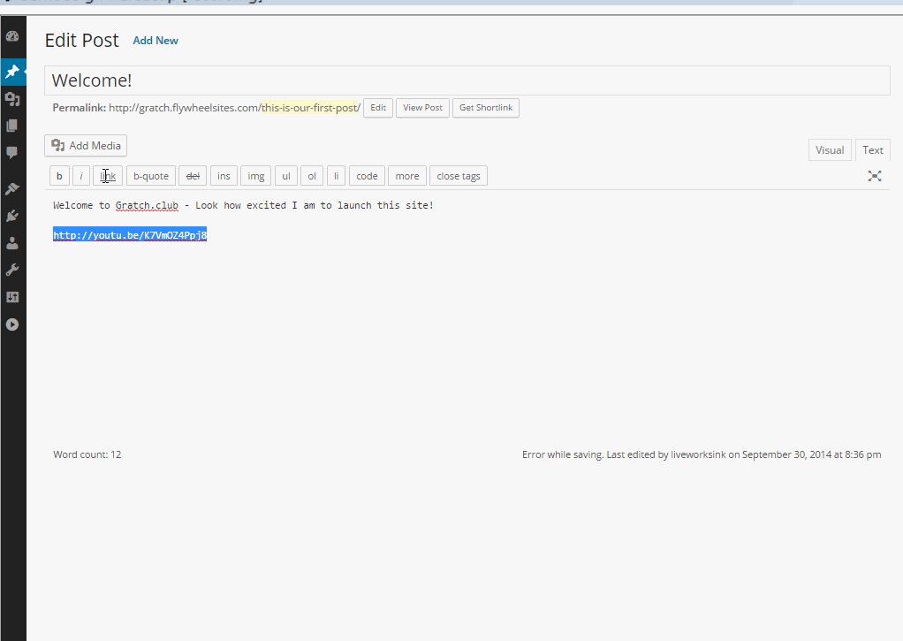
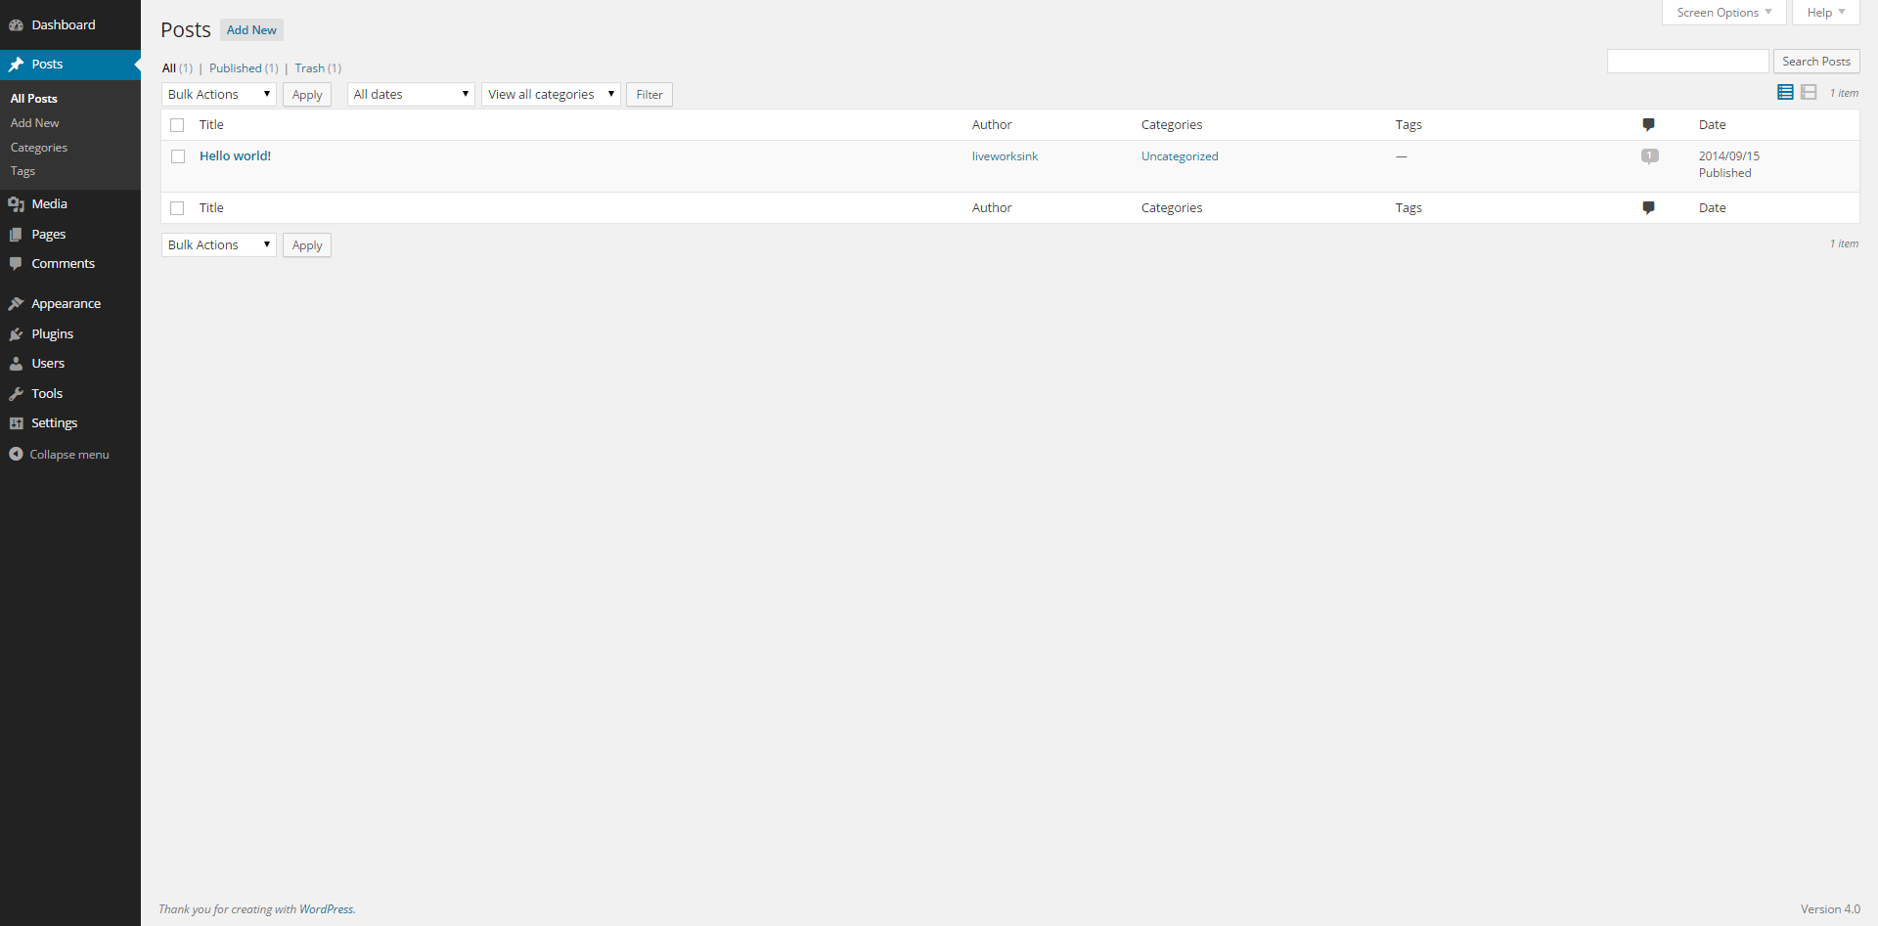
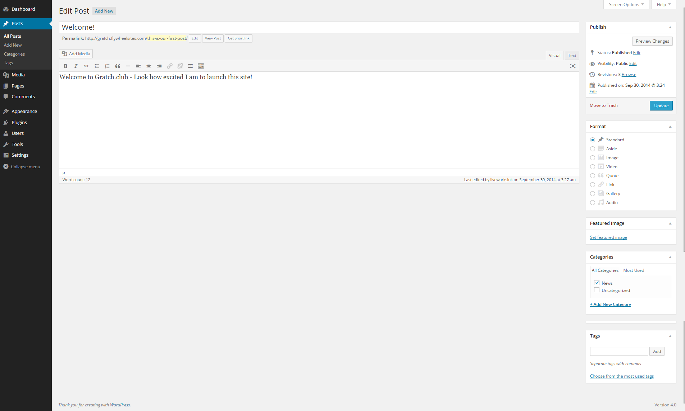
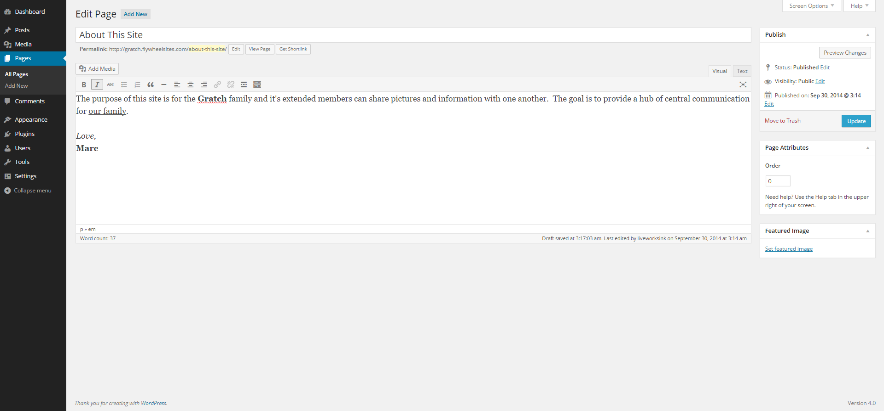
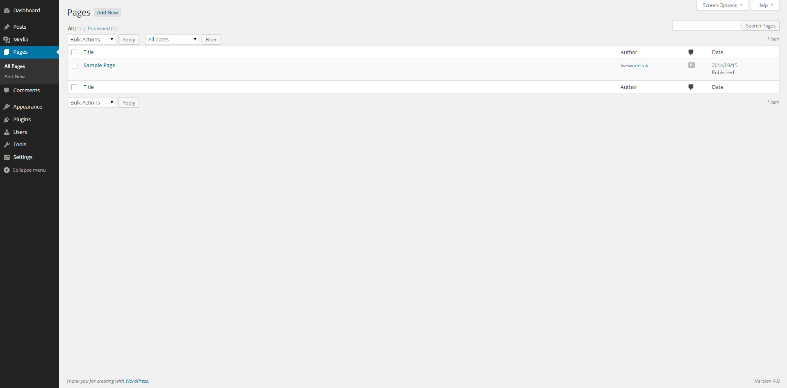
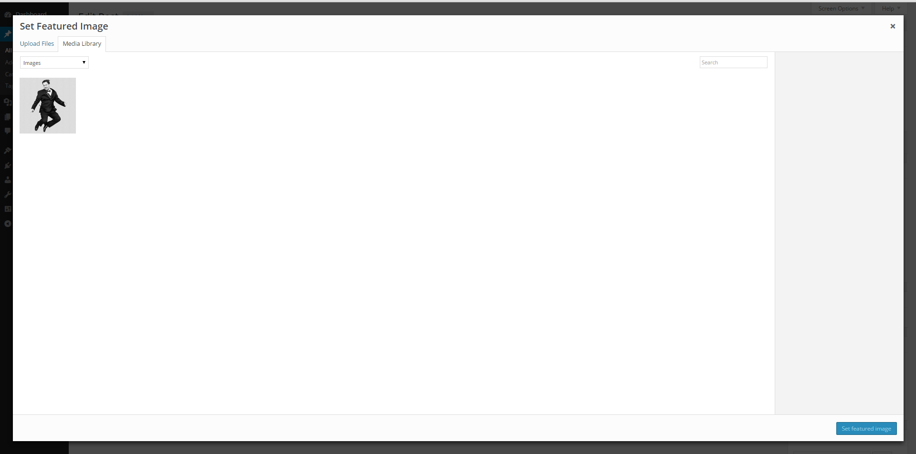
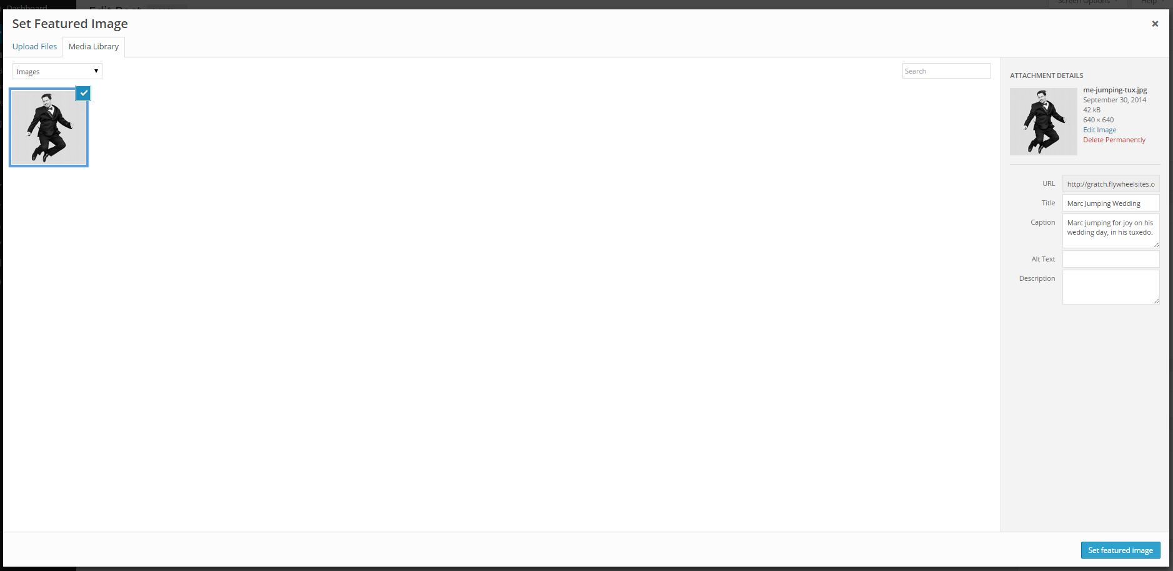
Add Content
Using the navigation on the left go to Posts.
Start by deleting the Sample Post “Hello World”
Click Add Post.
Using the navigation on the left go to Pages.
Start by deleting the Sample Page
Click Add Page.
Adding content to posts and pages are typically the same process with minor adjustments.
As simple as a word processor
Bold, underline, italics, numbered and bullet lists are all easily available to name a few.
A media box will pop up.
Select media from your media library or upload from your computer.
Then add a Title, Caption, Description and Alt tag to your image.
Click “Set Featured Image” or “insert into Post”
When inserting an image into your post, you can select justification, size, a link and other advanced options.
WordPress allows for easily embedding content in your site.
Add YouTube, twitter, vimeo, WordPress.tv, TED and many more.
Just copy/paste the URL directly into a post/page.
Adding an image to your post/page is easy!
Click the “Add Media” button.
Click “Add featured image”
By default WordPress has 5 areas to enter content.
Posts
Pages
Categories
Menu
Widgets

Slide 22
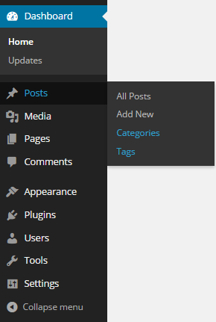
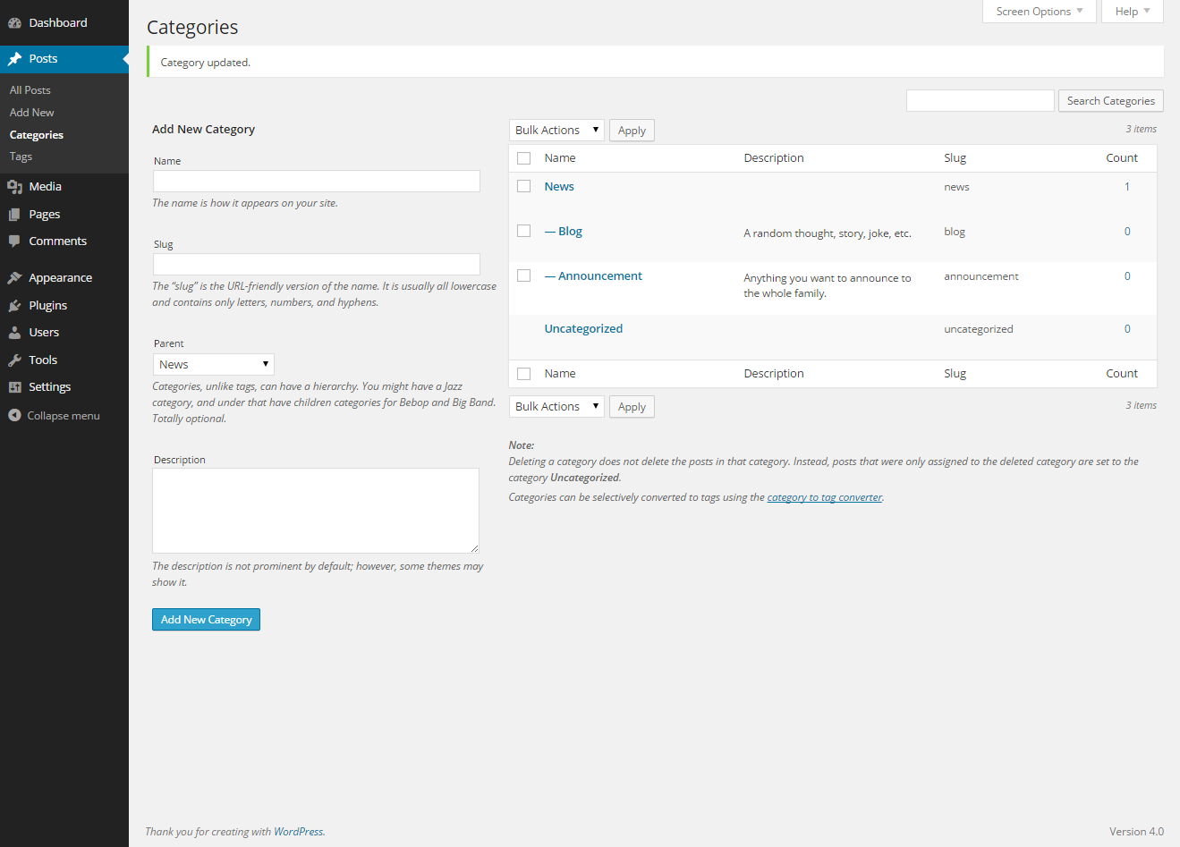
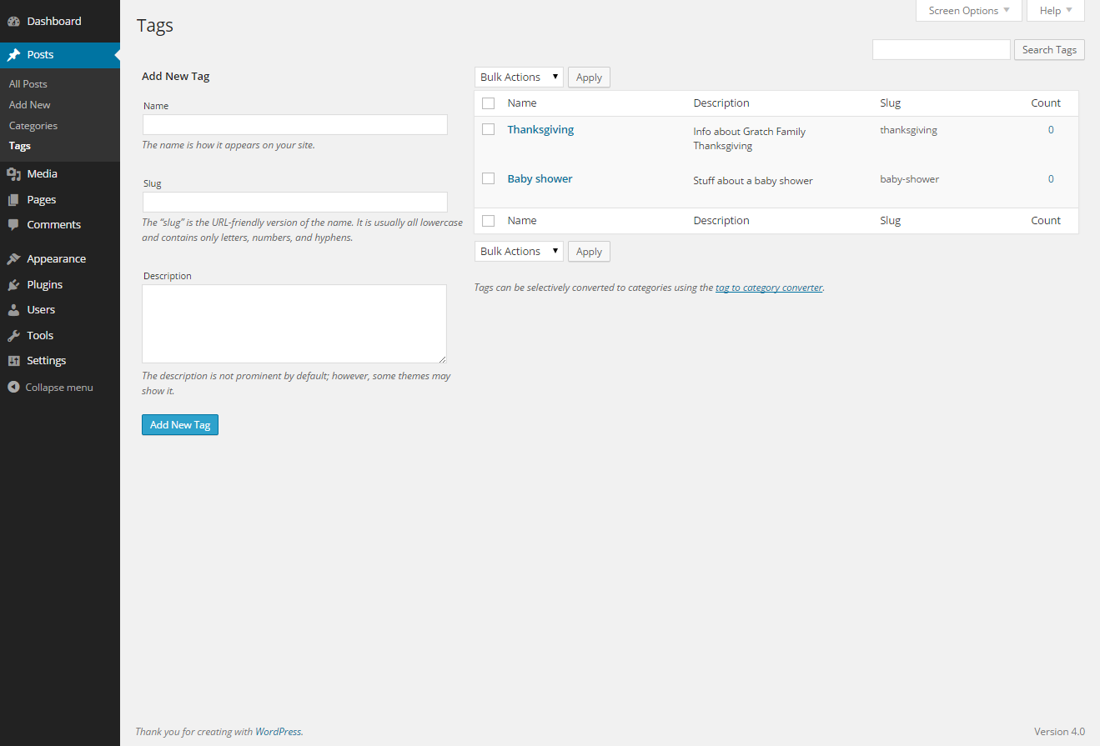
Categories and Tags
Tags are not hierarchal, i.e. there are no subcategories. A post about pizza from Sal’s pizza shop, might be in the subcategory “Junk Food” and tagged “Pizza.”
Tags are not required.
Categories are hierarchal. A personal blog may contain categories like:
Work
Hobbies
Food
Junk Food
Fine Dining
Home cooked
Posts must belong to at least 1 category.
“Categories allowed for a broad grouping of post topics”
“Tags are similar to categories, but they are generally used to describe your post in more detail.”
-WordPress.com

Slide 23
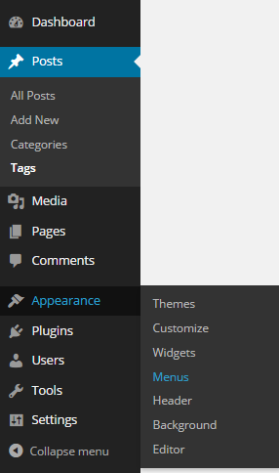
Custom Menus
WordPress By Default automatically displays all your pages in the primary menu. (Assuming the theme you chose has a primary menu defined.)
Go to the menu manager to add/edit/delete menus and menu items.

Slide 24
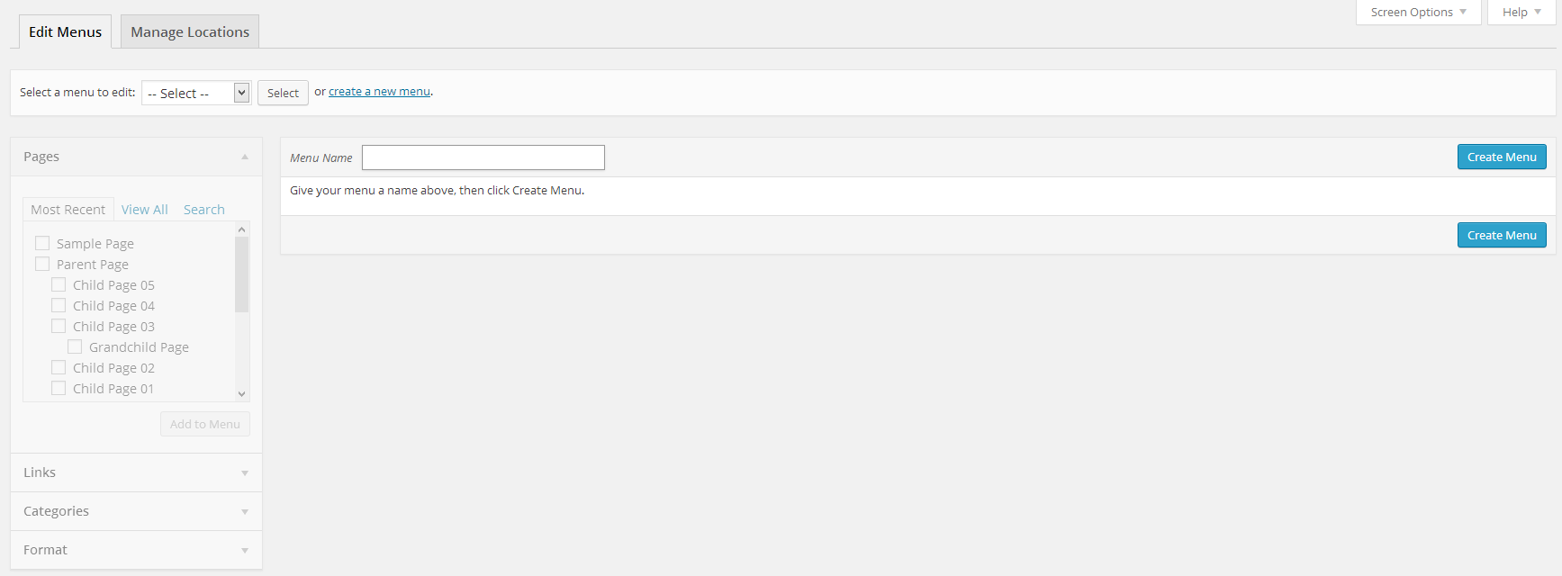
Defining a Menu
Select Create a new menu at the top of the page
Enter a name for your new menu in the Menu Name box
Click the Create Menu button.

Slide 25
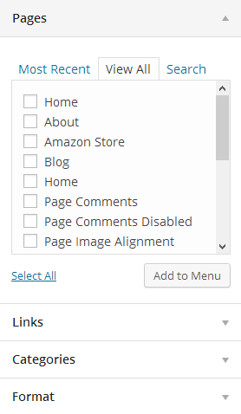
Adding a New Menu Item
Locate the pane entitled Pages.
Within this pane, select the View All link to bring up a list of all the currently published Pages on your site.
Select the Pages that you want to add by clicking the checkbox next to each Page's title.
Click the Add to Menu button located at the bottom of this pane to add your selection(s) to the menu that you created in the previous step.
Click the Save Menu button once you've added all the menu items you want.
Your custom menu has now been saved.

Slide 26
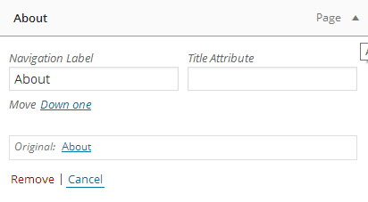
Deleting a Menu Item
Locate the menu item that you want to remove in the menu editor window
Click on the arrow icon in the top right-hand corner of the menu item/box to expand it.
Click on the Remove link. The menu item/box will be immediately removed.
Click the Save Menu button to save your changes.

Slide 27
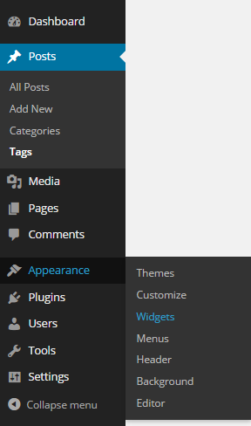
Widgets
Add, Arrange, and Remove custom content in available sidebars.

Slide 28
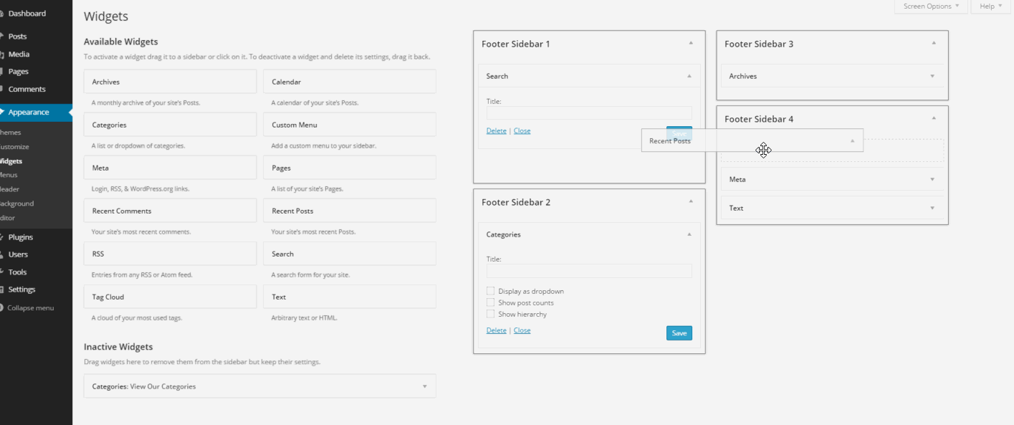
Add & Arrange Widgets with Drag & Drop.
To add a widget, drag the widget from the Available Widgets or Inactive Widgets area on the left into the Sidebar area on the right. When you see a dashed line appear, you can drop the widget into place.
You can also click on an Available Widget to choose which sidebar area you would like to assign it.
Change the order of the widgets by dragging and dropping them around in the sidebar.

Slide 29
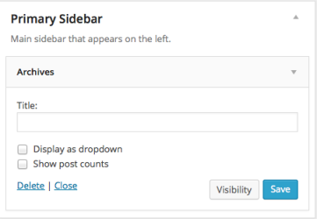
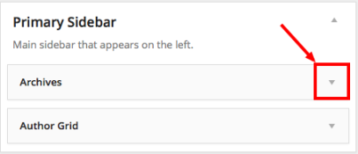
Configure Widget Options
Expand each widget to configure its options and delete the widget.

Slide 30
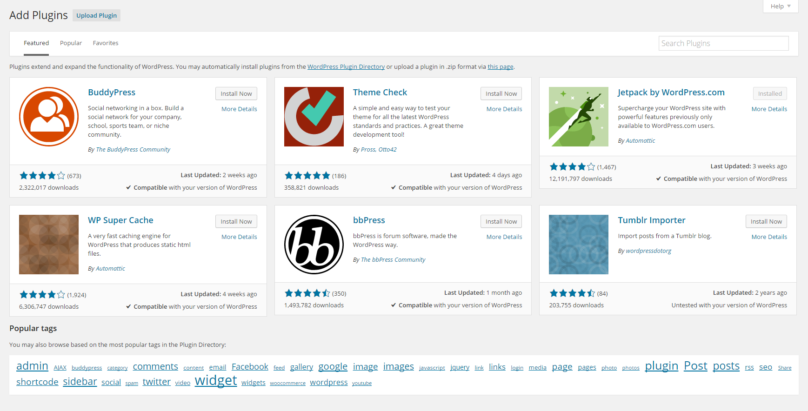
Wait how do I… //Do Something …Install a Plugin
WordPress Has 33,721 Plugins
Plugins extend WordPress, like an app extends your mobile device.

Slide 31

ONE Plugin to RULE them ALL
Behold:
Many of the features a new WordPress site needs is available through 1 plugin.

Slide 32
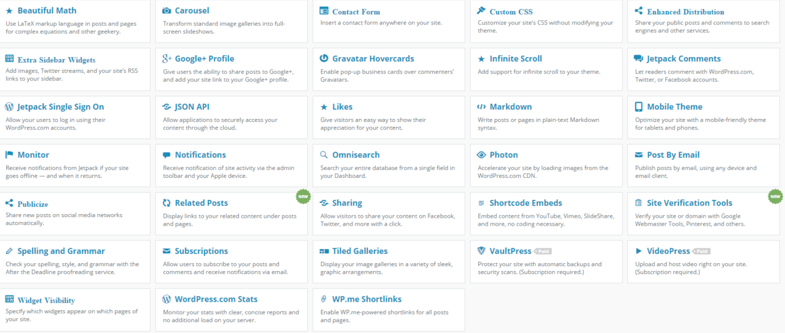
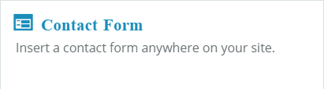
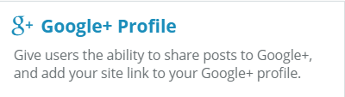

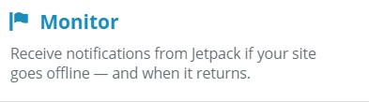
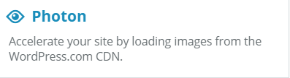
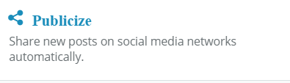
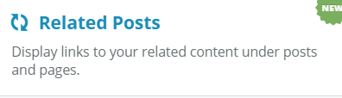

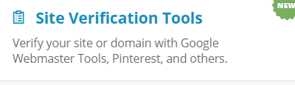






All the things Jetpack can do!

Slide 33
Contact Forms | Reach out and touch somebody…
Jetpack includes a contact form.
Button to Add form above the editor on Add/Edit Post/Page
Multiple field types to choose from
Drag and Drop to reorder form fields
Gravity Forms and NinjaForms are very similar plugins with different pricing models.
Button to Add form above the editor on Add/Edit Post/Page
Build complex workflows
Conditional Logic
Drag and Drop to reorder form fields
Integrate with payment systems, CRMs, and many other 3rd party services.
Jetpack Contact Form
Gravityforms
Ninjaforms
Many Many More

Slide 34
SEO Tips
A few well rounded SEO Plugins:
WordPress SEO
All in One SEO Pack
SEO Ultimate
WordPress SEO Premium
Integration with Google Webmaster Tools
Redirect Manager
Video Tutorials for the entire plugin
WordPress Social Sharing Optimization (WPSSO)
Could be a game changer?
Google Authorship?
Site Title
Site Description/Tagline
Permalinks
SSL
Rich Snippets
Social Media Sharing/Publishing
Keyword Research
Relevant Content
SEO Plugin

Slide 35
Securing WordPress
Great Security Plugins:
iThemes Security (formerly Better WP Security)
Sucuri Security - Auditing, Malware Scanner and Hardening
WordFence Security
BulletProof Security
Great Backup plugins:
Backup Buddy
VaultPress
I have not included a free plugin here as I have yet to find one that I like that offers FULL site backups.
Most Managed hosts offer nightly & 1 click backups without the need of a plugin.
Don’t Use the Username “Admin”.
Use a separate account for managing your site and writing content.
Scheduled Offsite Backups
Keep WordPress and all plugins and themes up to date.
SSL Encryption
Use a plugin for Advanced Security

Slide 36
Selling Stuff - WordPress & eCommerce
A few Great eCommerce Plugins:
iThemes Exchange
WP-Ecommerce
WooCommerce
Easy Digital Downloads
Gravity Forms
WordPress has a few hundred eCommerce Plugins which provide a wide range of options to sell your product, whatever that may be.

Slide 37
Post Types, Taxonomies, and Shortcodes. Oh my!
Shortcodes:
“A shortcode is a WordPress-specific code that lets you do nifty things with very little effort.” -From WordPress.com
To insert a gallery of images in your post you would type [gallery] in the editor. (Include the brackets.)
Built in Post Types:
Posts
Pages
Media (Attachments)
Custom Post Types:
Custom Post Types are the way plugins can create a store different types of content not built into WordPress by default.
Built in Taxonomies:
Categories
Tags
Custom Taxonomies:
Custom Taxonomies are just like Categories and Tags with a custom name and must be associated with a post type (custom or built in.)
What is a Post Type?
A post type is how WordPress Stores many different types of content.
What is a Taxonomy?
A taxonomy is a way to group things together.

Slide 38
WordPress Resources
My WordPress Feedly:
Podcasts:
chrislema.com
helenhousandi.com
Make WordPress
Matt Mullenweg
Pippins Plugins
Post Status
Rezzz.com
tommcfarlin.com
Tuts+
WebDevStudios.com
WordPress News
WordPress Tavern
WordPress.tv
WP Mayor
WPBeginner
WPLift
WPMU DEV's
WPRecipes.com
WPShout.com
Yoast
carriedils.com
scotty-t.com
WPChat
Apply Filters
WordPress Weekly
WP Watercooler
The Dradcast
The Matt Report
WPCAST.FM
WP Elevation
Genesis Office Hours
WPTheory.fm
Artofvalue.com
Feel free to contact me.
Twitter: mgratch
Website: marcgratch.com
Email: me@marcgratch.com

